Slide 1
Principal Componen Analysis (PCA)
Tim Pengajaran
Mata Kuliah Machine Learning
Jurusan Teknologi Informasi Tahun 2021

Slide 2
Disclaimer
This presentation material, including examples, images, references are provided for informational and explanation assistance only
The names of actual products and companies mentioned here in, if any, may be the trademarks of their respective owners
Credits shall be given to the images taken from the open-source and cannot be used for promotional activities

Slide 3
Outline
Principal Component Analysis (PCA)
Visualizing High-Dimensional Data
Use Case: Face Recognition – Do yourself

Slide 4
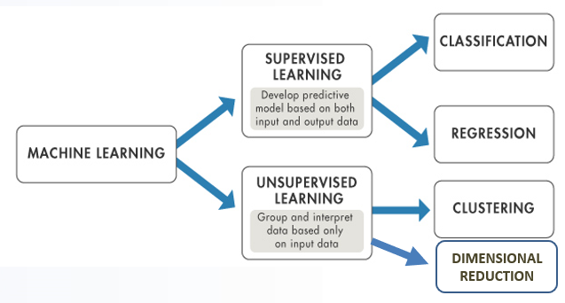
Reminder

Slide 5
Principal Component Analysis (PCA)
A dimensionality-reduction method to reduce the dimensionality of large data sets, by transforming a large set of variables into a smaller one that still contains most of the information in the large set.
Used to:
Reduce a set of possibly correlated high-dimensional variables to a lower dimensional set of linearly uncorrelated synthetic variables called principal components.
Mitigate problems caused by the curse of dimensionality.
Compress data while minimizing the amount of information that is lost before used by another estimator.
Visualize a high-dimensional dataset in two dimensions.

Slide 6
Principal Component Analysis (PCA)
Known as the Karhunen-Loeve Transform (KLT), is a technique for finding patterns in high-dimensional data.
Reduces the dimensions of a dataset by projecting the data onto a lower dimensional subspace.
In general, an m-dimensional dataset can be reduced by projecting onto an n-dimensional subspace, where n is less than m.
To find a set of vectors that span a subspace that minimizes the sum of the squared errors of the projected data which will retain the greatest proportion of the original dataset's variance.

Slide 7
Why Reduce the Dimension?
As the number of dimensions of a dataset increases, the number of samples required for an estimator to generalize increases exponentially.
Acquiring large data may be infeasible in some applications.
Learning from large datasets requires more memory and processing power.
It can become more difficult to detect similar instances in high-dimensional space as all instances are similarly sparse

Slide 8
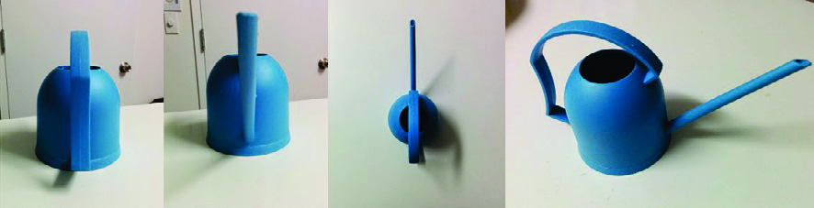
Perspectives of PCA
The first photograph – the back of the watering can is visible, but the front cannot be seen.
The second one – it is angled to look directly down the spout of the watering can; the front of the can that was not visible in the first photograph, but now the handle cannot be seen.
The third one – the height of the watering can cannot be discerned from the bird's eye view.
The fourth one – the watering can's height, top, spout, and handle are all discernible in this image.
PCA projects data in a high-dimensional space to a lower dimensional space such that it retains as much of the variance as possible.

Slide 9
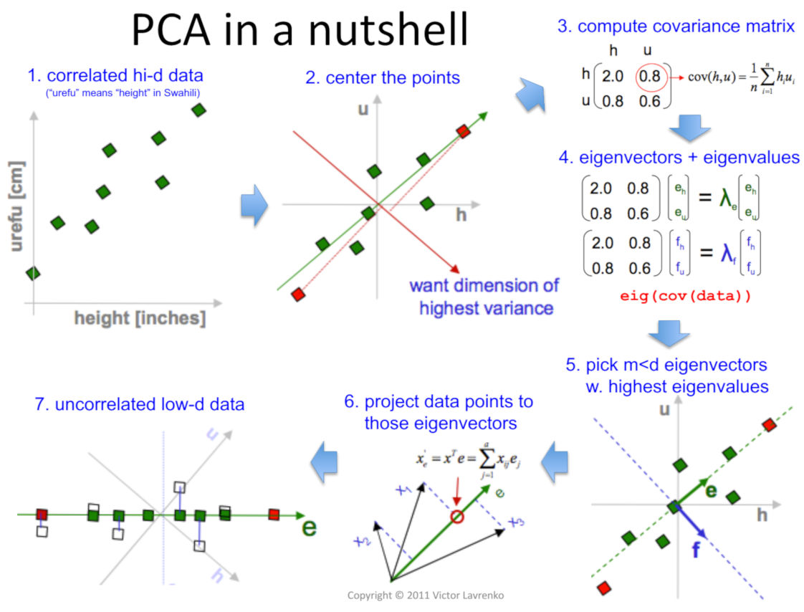
PCA Illustration

Slide 10
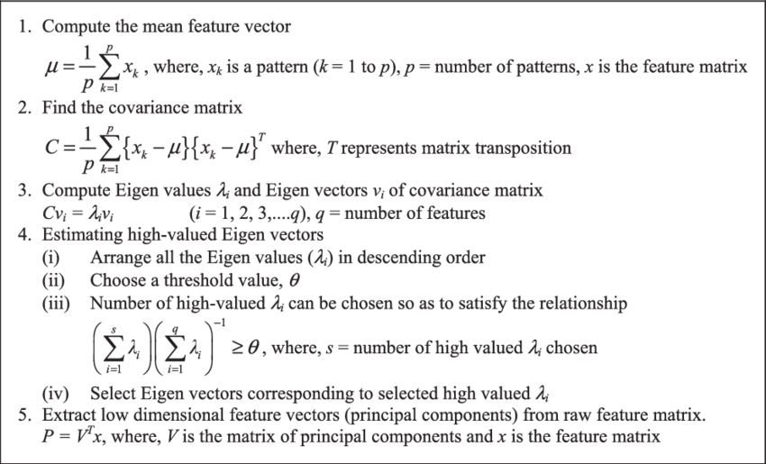
PCA Algorithm

Slide 11
PCA Algorithm – Simple
Standardize the data. (with mean = 0 and variance = 1)
Compute covariance matrix of dimensions.
Obtain the Eigenvectors and Eigenvalues from the covariance matrix (we can also use correlation matrix or even Single Value Decomposition).
Sort eigenvalues in descending order and choose the top k Eigenvectors that correspond to the k largest eigenvalues (k will become the number of dimensions of the new feature subspace k ≤ d, d is the number of original dimensions).
Construct the projection matrix W from the selected k Eigenvectors.
Transform the original data set X via W to obtain the new k-dimensional feature subspace Y.

Slide 12
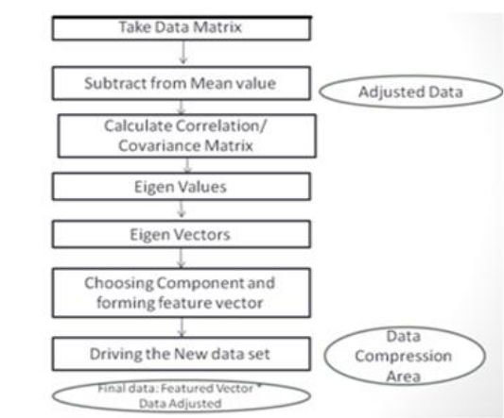
PCA Flowchart

Slide 13
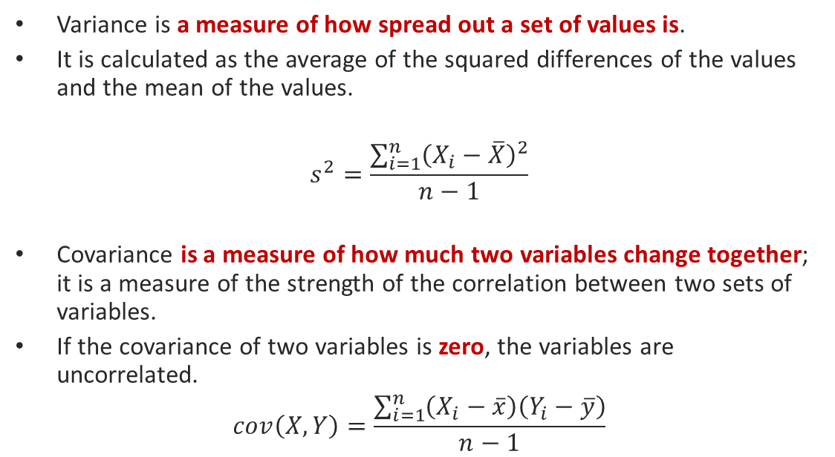
Variance and Covariance
Variance is a measure of how spread out a set of values is.
It is calculated as the average of the squared differences of the values and the mean of the values.
$$s^{2}=\frac{\sum_{i=1}^{n}{{\left(X_{i}−\overline{X}\right)}^{2}}}{n−1}$$
Covariance is a measure of how much two variables change together; it is a measure of the strength of the correlation between two sets of variables.
If the covariance of two variables is zero, the variables are uncorrelated.
$$cov\left(X,Y\right)=\frac{\sum_{i=1}^{n}{\left(X_{i}−\overline{x}\right)\left(Y_{i}−\overline{y}\right)}}{n−1}$$

Slide 14
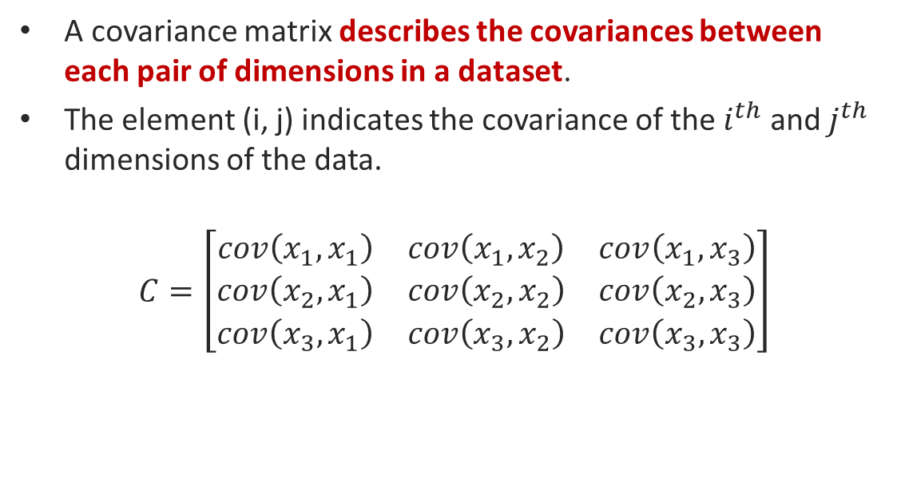
Covariance Matrices
A covariance matrix describes the covariances between each pair of dimensions in a dataset.
The element (i, j) indicates the covariance of the $i^{th}$ and $j^{th}$ dimensions of the data.
$$C=\left[\begin{matrix}cov\left(x_{1},x_{1}\right) & cov\left(x_{1},x_{2}\right) & cov\left(x_{1},x_{3}\right) \\ cov\left(x_{2},x_{1}\right) & cov\left(x_{2},x_{2}\right) & cov\left(x_{2},x_{3}\right) \\ cov\left(x_{3},x_{1}\right) & cov\left(x_{3},x_{2}\right) & cov\left(x_{3},x_{3}\right)\end{matrix}\right]$$

Slide 15
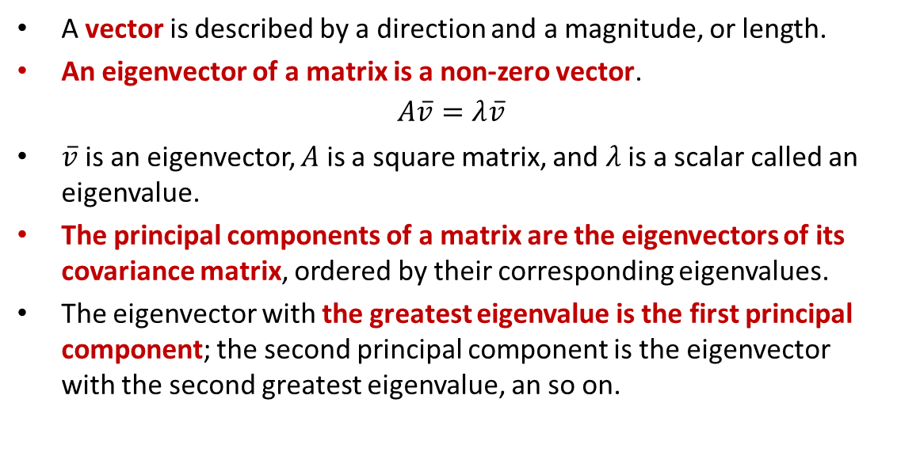
Eigenvectors and Eigenvalues
A vector is described by a direction and a magnitude, or length.
An eigenvector of a matrix is a non-zero vector.
$$A\overline{v}=λ\overline{v}$$
$\overline{v}$is an eigenvector, $A$ is a square matrix, and $λ$ is a scalar called an eigenvalue.
The principal components of a matrix are the eigenvectors of its covariance matrix, ordered by their corresponding eigenvalues.
The eigenvector with the greatest eigenvalue is the first principal component; the second principal component is the eigenvector with the second greatest eigenvalue, an so on.

Slide 16

Let’s See How PCA Works

Slide 17
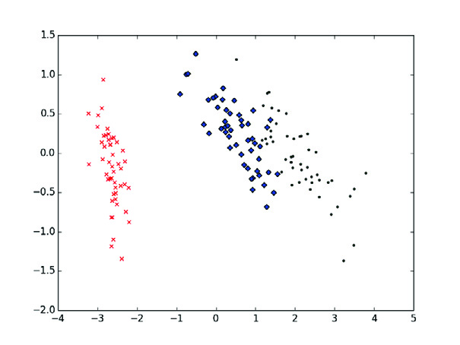
Visualizing H-Dim Data
Fisher's Iris dataset is The Iris dataset is commonly used to test classification models.
Reduce the iris dataset’s four dimensions to visualize it in two dimensions.
It is clear that one of the classes can be easily separated from the other two overlapping classes

Slide 18
Homeworks
Practice all PCA computer programs in the book and collect them via LMS.

Slide 19
Thank You for Today
Always Keep Your Spirit!

